Slide 1
Anomaly Detection in Graphs and Time Series
Bryan Hooi
bhooi@andrew.cmu.edu
Notes:
Hi everyone. Thanks for coming to my talk. I’m Bryan and I’ll be talking about anomaly detection in graphs and sensor data.

Slide 2
Notes:
When I was younger, a common mistake I used to make was to take the bus going in the wrong direction.

Slide 3
Notes:
Initially, I wouldn’t notice anything wrong, but over time, I would gradually notice that the buildings and roads don’t seem quite right… and finally, I’d notice it and get off the bus.

Slide 4
Anomaly Detection
For humans:
Anomaly
In computer science:
Anomaly
Massive graphs / sensor data
40B+ web pages
12GB / second
Notes:
This task of noticing that something is wrong, is an important one not just for humans, but also in computer science.
In many applications, we have massive graphs or sensor data. Hence, it’s important to have algorithms which can automatically identify anything unusual in the data, so that we can respond to any anomalies quickly.

Slide 5
What is an Anomaly?
Observations that appear to be inconsistent with the remainder of the data
(e.g. surprising / unexpected)
[Barnett & Lewis ‘94]
Review
Fraud
Insurance
Fraud
Cyberattacks
Malware
Web Spam
Industrial
Faults
Medical Conditions
Air Quality
Power Grid
Failures
Disease
Outbreak
Money Laundering
Road Accidents

Slide 6
Anomaly Detection: Theory vs. Practice
Standard Approaches
Real-World Challenges
Thesis Focus
Graph Data
Time Series
Outlier Detection
Heterogeneous Data
Streaming Data
Gap
Adversarial
Robustness
Interpretability
User Feedback / Preferences
Change Detection
Group Anomalies

Slide 7
My Research Goal
To develop fast, principled algorithms for anomaly detection in graphs and time series.
Dynamic
Graphs
Time
Series
Graphs
(Part 1)
(Part 2)
(Part 3)
Notes:
This brings us to my research goal, which is to develop fast, principled algorithms for anomaly detection in graphs and time series.
I focus on graphs and time series as they are common in real-world anomaly detection tasks. Dynamic graphs combine graph and time series information.

Slide 8
T1. Graphs
Ratings Fraud
Notes:
Let’s look at some concrete examples. For graphs, imagine an Amazon like setting, where we have users rating a set of products, where edges indicate ratings.
We want to detect ratings fraud, or a group of bots which work together to boost the ratings of a set of products, by adding a lot of fake ratings.

Slide 9
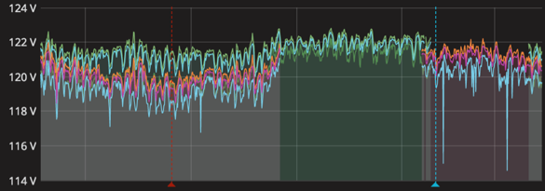
T2. Time Series
detect
Electrocardiogram (ECG) Data
Abnormal Heart Rhythms
detect
Power Grid Sensor Data
Power Grid Failures
Notes:
For time series, one example is electrocardiogram or ECG data. Anomalies here indicate abnormal heart rhythms, which can be medically important.
Similarly, anomalies in power grid sensor data can indicate power grid failures.

Slide 10
T3. Dynamic Graphs
Traffic Graph
Power Grid
Other Applications
Notes:
Dynamic graphs combine graphs and time series.
Imagine a road traffic graph, where we have sensors along some roads measuring the speed of vehicles, and we want to detect traffic accidents.
Similarly, we have a graph of the power grid, on which there are sensors measuring the current flowing over them, and we want to detect electrical failures.

Slide 11
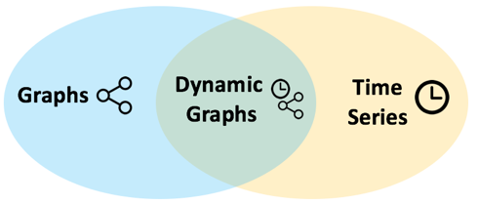
Research Topics
T2. Time
Series
T3. Dynamic
Graphs
T1. Graphs
• Link Fraud
• Ratings Fraud
• Dynamic Subgraphs
[KDD16, TKDD17, WSDM18]
[SDM16]
[ECML18, CIKM18]
Type of Anomaly
• Subtensors
• Power Grid
• Tensor Streams
[ICDM15, TKDE16, ECML16, WSDM17, TKDD18]
[ECML17, ISGT17, IJCAI18, SDM18]
[KDD17, WWW17, ECML17, CIKM17, TKDE18, SDM19]
• Patterns
[ECML17, SDM19]
Hooi, Song, Beutel, Shah, Shin, and Faloutsos. “FRAUDAR: Bounding Graph Fraud in the Face of Camouflage.” KDD 2016.
Notes:
In this talk, I will describe 3 works: detecting link fraud in graphs, detecting ratings fraud in time series, and detecting subgraphs in dynamic graphs.

Slide 12
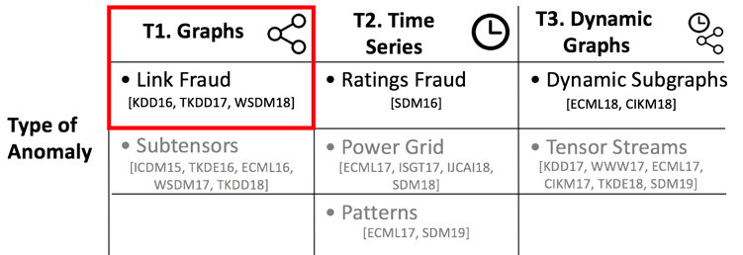
Road Map
T1. Detecting Camouflaged Link Fraud
Problem
Measure
Properties
Experiments
T2. Detecting Ratings Fraud
T3. Detecting Anomalous Dynamic Subgraphs
Future Directions
Notes:
Now let’s go into our first paper, which is on detecting camouflaged link fraud in graphs. I’ll start by introducing the problem.

Slide 13
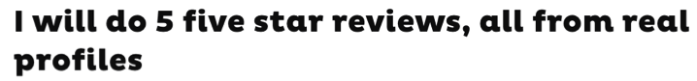






Fake Reviews
Detecting Anomalous Subgraphs
Notes:
Fake reviews are a major problem in online commerce, as they mislead customers.
These screenshots show people selling all kinds of fake reviews online, for products or apps.

Slide 14

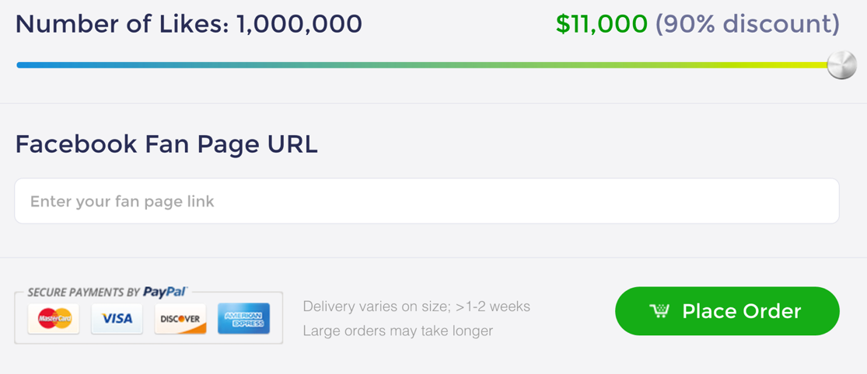
Other Applications
Boosting Twitter follows
Q: How to spot these?
Boosting Facebook `Likes’
Detecting Anomalous Subgraphs
Notes:
Similarly, services exist to boost twitter follows or facebook likes.
Our goal is to spot these fake reviews.

Slide 15
Informal Problem Overview
Given:
Bipartite graph between users and products
Detect:
Fraudulent activity
Products
0
Users
1
0
Edges = reviews
Detecting Anomalous Subgraphs
Notes:
I’ll now introduce our problem informally. We are given a bipartite graph between users and products.
In this adjacency matrix, the rows represent users, columns represent products, and an entry indicates that the user reviewed that product.
We wish to detect fraudulent activity: we will discuss how to measure this later.

Slide 16
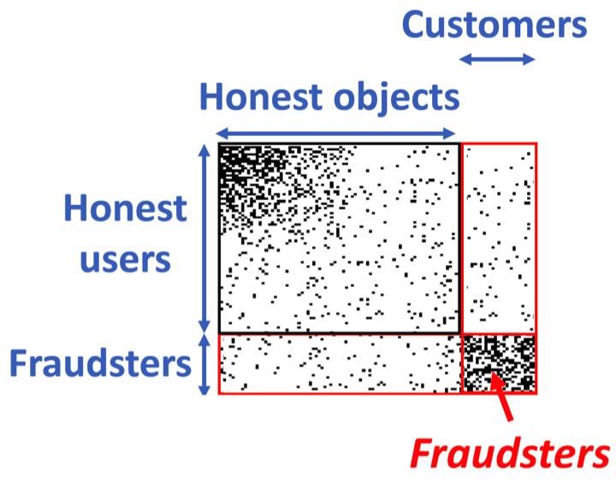
Detecting Review Spam
Background
Many existing methods detect dense subgraphs.
Products
Fraud Customers
Spectral methods
Community detection
Users
Belief propagation
Detecting Anomalous Subgraphs
Notes:
Many existing fraud detection methods work by detecting dense subgraphs. The idea is that fraudsters often reuse their fraudulent accounts, leading to a dense region in the bottom right.
This can be detected using spectral methods, community detection, or belief propagation.

Slide 17
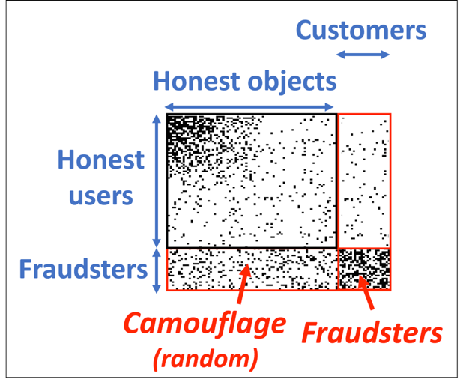
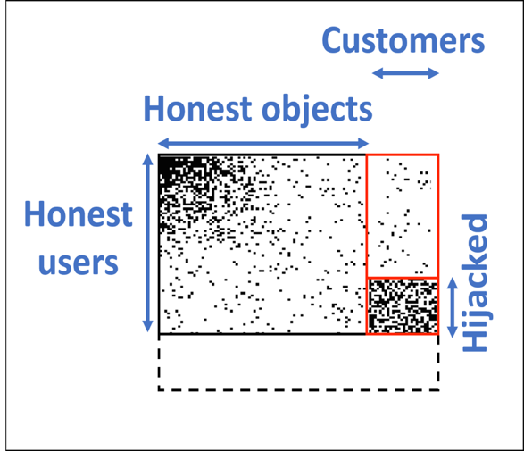
Evading Detection
Background
Attackers use camouflage to evade detection.
Fraud Customers
Fraud Customers
Random camouflage
Hijacking
Detecting Anomalous Subgraphs
Notes:
However, attackers can use camouflage to evade detection, which means adding fake reviews for honest objects, in order to appear honest.
In the left picture, the fraudsters do this by adding reviews for random objects.
In the right picture, the fraudsters hijack honest user accounts’ and use them to boost the customers.

Slide 18
Problem Definition
Given:
Bipartite graph between users and products
(optional: prior node suspiciousness a_{i} )
Detect fraudulent attacks:
In near-linear time
With provable bounds
Camouflage-resistant
Products
0
Users
2
2
0
1
1
1
Node
scores a_{i}
Detecting Anomalous Subgraphs
Notes:
Now I will formally define our problem.
We are given a bipartite graph, and optionally a set of node scores a_i, which represent our prior suspiciousness about each node. These can be used to incorporate side information, such as user profiles or text.
Our goal is to detect fraudulent attacks in near-linear time, with provable bounds, and resistant to camouflage, which I’ll define formally in later slides.

Slide 19
Road Map
T1. Detecting Camouflaged Link Fraud
Problem
Measure
Properties
Experiments
T2. Detecting Ratings Fraud
T3. Detecting Anomalous Dynamic Subgraphs
Future Directions
Notes:
Next, I will describe our FRAUDAR measure.

Slide 20
Suspiciousness Metrics
Products
Products
B
Users
Users
B
A
A
g(A, B) = 5
g(A, B) = 20
Detecting Anomalous Subgraphs
Notes:
A suspiciousness metric g is any function that takes a set of users A and products B, and outputs a value representing how suspicious they are.
We would like it to output a low score if A and B are normal, and a high score if they are abnormal.

Slide 21
Camouflage Resistance
g is camouflage-resistant if g(A, B) does not decrease when camouflage is added to the rows of A.
Products
Users
B
B
A
A
Camouflage
g(A, B) = 50
g(A, B) = 50
Detecting Anomalous Subgraphs
Notes:
What does camouflage resistance mean? We say that g is camouflage resistant t if the metric value g(A,B) does not decrease when we add camouflage to the rows of A.
In other words, if the attacker adds any number of ones to the rows of A, if g(A,B) was originally 50, it should not drop below 50.

Slide 22
Proposed FRAUDAR Measure
Products
0
Node
scores a_{i}
0
Users
B
1
3
2
2
2
2
Edge scores c_{ij}
A
3
2
2
2
2
3
3
2
2
2
0
1
1
1
1
1
1
1
(sum of node scores) + (sum of edge scores)
12 + 24
g(A, B) =
=
|A| + |B|
7
Detecting Anomalous Subgraphs
Notes:
Now I will describe our FRAUDAR measure. Here the blue numbers are the optional node scores, and the red numbers are edge scores. I will describe how to define the edge scores later.
First, in the numerator we have the sum of node scores of A and B. In this example, we add up the blue values to get 12.

Slide 23
Proposed FRAUDAR Measure
Products
0
Node
scores a_{i}
0
Users
B
1
3
2
2
2
2
Edge scores c_{ij}
A
3
2
2
2
2
3
3
2
2
2
0
1
1
1
1
1
1
1
(sum of node scores) + (sum of edge scores)
12 + 24
g(A, B) =
=
|A| + |B|
7
Detecting Anomalous Subgraphs
Notes:
Next, we also add the sum of edge scores in the block, which gives 24.

Slide 24
Proposed FRAUDAR Measure
Products
0
Node
scores a_{i}
0
Users
B
1
3
2
2
2
2
Edge scores c_{ij}
A
3
2
2
2
2
3
3
2
2
2
0
1
1
1
1
1
1
1
(sum of node scores) + (sum of edge scores)
12 + 24
g(A, B) =
=
|A| + |B|
7
Detecting Anomalous Subgraphs
Notes:
Lastly, we divide by the sum of sizes of A and B. This is because for the same node and edge score, smaller blocks should be more suspicious.

Slide 25

How About Other Measures?
(sum of node scores) + (sum of edge scores)
g(A, B) =
|A| + |B|
|A| • |B|
|A| • |B|
Probabilistic Approach
(Maximized at single edge)
M-Zoom [ECML16]
TellTail (Ch. 3)
Detecting Anomalous Subgraphs
Notes:
Lastly, we divide by the sum of sizes of A and B. This is because for the same node and edge score, smaller blocks should be more suspicious.
Add section number to telltail and mzoom
Add mzoom - attributes

Slide 26



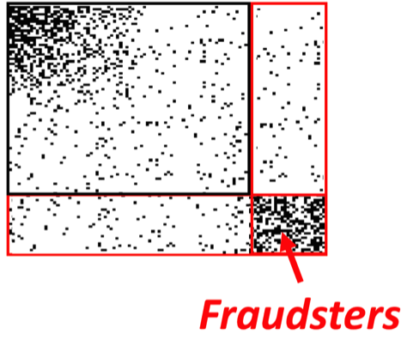

Proposed Edge Scores
(1M reviews)
(1000 reviews)
Intuition:
Popular products ( ) are not necessarily suspicious
Fraudulent products ( ) have a high fraction of edges from fraud
Honest users
FRAUDAR edge scores: c_{ij} = 1/log(unweighted sum of jth column)
tf-idf
Detecting Anomalous Subgraphs
Notes:
We now define our edge scores c_ij.
We want to catch fraud, not popular products. Imagine a very popular product, like coffee, with 1 million reviews. If we weighted all edges equally, the densest block would likely contain many such popular products, and miss the block at the bottom right.
In contrast, consider a fraudulent product, like this lemon. We assume that fraudulent products have a high fraction of edges from fraud, otherwise they wouldn’t be profiting significantly from the fraud. Thus, almost all of the lemon’s edges are from fraudsters. Thus, if we apply a downweighting based on column sum, the blue block will be downweighted a lot, but the red block will be less affected.
This downweighting of popular items is similar to tf-idf in information retrieval, which often uses log weighting, and we find that it performs well in our case as well.

Slide 27
Road Map
T1. Detecting Camouflaged Link Fraud
Problem
Measure
Properties
Experiments
T2. Detecting Ratings Fraud
T3. Detecting Anomalous Dynamic Subgraphs
Future Directions
Notes:
Next, I describe the properties of our measure.

Slide 28

Properties
Is our FRAUDAR measure:
Optimizable in near-linear time,
With theoretical guarantees,
Camouflage-resistant, and
Effective in practice?
Detecting Anomalous Subgraphs

Slide 29
Greedy Algorithm
1. Start with sets A, B as all users / products
B
0
0
1
A
3
2
2
2
2
3
2
2
2
2
3
3
2
2
2
0
1
1
1
1
1
1
1
Detecting Anomalous Subgraphs
Notes:
We use a greedy top down algorithm: we start with A as the set of all users and B as all products.

Slide 30
Greedy Algorithm
2. Find row / column with smallest total score.
B
0
0
1
A
3
2
2
2
2
3
2
2
2
2
3
3
2
2
2
0
1
1
1
1
1
1
1
Detecting Anomalous Subgraphs
Notes:
In each iteration, we find the row or column with smallest total score

Slide 31
Greedy Algorithm
3. Delete rows / columns greedily to maximize FRAUDAR
0
B
0
1
A
3
2
2
2
2
3
2
2
2
2
3
3
2
2
2
0
1
1
1
1
1
1
1
Detecting Anomalous Subgraphs
Notes:
And remove the row or column. Then we compute the new value of our FRAUDAR measure.

Slide 32
Greedy Algorithm
3. Delete rows / columns greedily to maximize FRAUDAR
0
0
B
B
0
0
1
1
A
A
2
2
2
2
2
2
2
3
2
3
2
2
2
2
2
3
2
2
3
2
2
2
2
2
3
2
3
3
3
1
0
1
0
1
1
1
1
1
1
1
1
1
1
1
1
Detecting Anomalous Subgraphs
Notes:
This continues

Slide 33
Greedy Algorithm
3. Delete rows / columns greedily to maximize FRAUDAR
0
0
B
1
3
2
2
2
2
A
3
2
2
2
2
3
3
2
2
2
0
1
1
1
1
1
1
1
Detecting Anomalous Subgraphs
Notes:
And continues

Slide 34
Greedy Algorithm
4. Continue until A and B are empty
0
0
1
3
2
2
2
2
3
2
2
2
2
3
3
2
2
2
0
1
1
1
1
1
1
1
Detecting Anomalous Subgraphs
Notes:
Until A and B are empty

Slide 35
Greedy Algorithm
5. Return the best subsets A and B seen so far (based on our measure)
0
0
B
1
3
2
2
2
2
A
3
2
2
2
2
3
3
2
2
2
0
1
1
1
1
1
1
1
Detecting Anomalous Subgraphs
Notes:
We then return the best subsets A and B seen so far, based on our FRAUDAR measure.

Slide 36
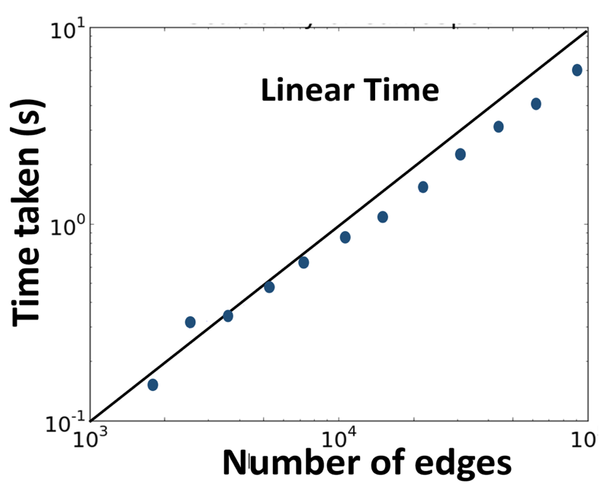
Computation Time
O(|E| log |V|)
(using appropriate data structures)
5
Detecting Anomalous Subgraphs
Notes:
This can be done in near-linear time using appropriate heap data structures.
This plot verifies that the growth is parallel to the main diagonal, indicating linear time.

Slide 37

Properties
Is our FRAUDAR measure:
Optimizable in near-linear time,
With theoretical guarantees,
Camouflage-resistant, and
Effective in practice?
Detecting Anomalous Subgraphs
Notes:
Next we show theoretical guarantees for FRAUDAR

Slide 38
Properties: Approximation Guarantee
Theorem 1: Approximation Guarantee
The subgraph (A, B) returned by FRAUDAR satisfies:
1
g (A ∪ B) ≥ g_{OPT}
2
Our subgraph
Optimum value of g
Products
Our subgraph
Users
2×
Optimum subgraph
Detecting Anomalous Subgraphs
Notes:
The subgraph our algorithm returns has at least half the value of the optimum subgraph

Slide 39
Properties: Camouflage Resistance
Theorem 2: Camouflage Resistance
The FRAUDAR measure is camouflage-resistant.
j
tf-idf
Intuition:
Edge scores c_{ij} are a function of the column they are in,
Camouflage only affects the rows
Camouflage
i
c_{ij}
A
Detecting Anomalous Subgraphs
Notes:
Our 2nd theorem says that the FRAUDAR measure is camouflage resistant: adding camouflage cannot decrease the measure value.
The intuition is that FRAUDAR is a function of the edge scores c_ij, which are a function of the column j. However, camouflage only affects the rows, hence, it cannot be used to decrease the value of the FRAUDAR metric.

Slide 40
Properties
Is our FRAUDAR measure:
Optimizable in near-linear time,
With theoretical guarantees,
Camouflage-resistant, and
Effective in practice?
Detecting Anomalous Subgraphs
Notes:
Finally, we show that FRAUDAR is effective in practice.

Slide 41
Road Map
T1. Detecting Camouflaged Link Fraud
Problem
Measure
Properties
Experiments
T2. Detecting Ratings Fraud
T3. Detecting Anomalous Dynamic Subgraphs
Future Directions
Notes:
We show this using experiments on real and synthetic data.

Slide 42
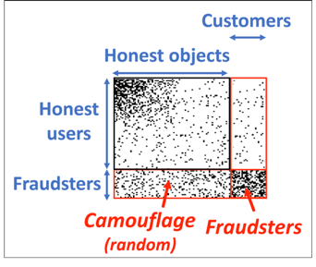
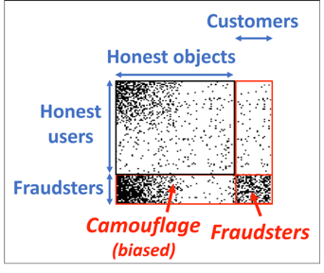
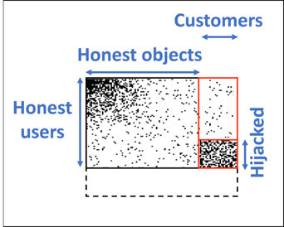
Experiments: Amazon Data
Review graph
24K users x 4K products
Injected 200 x 200 blocks with various types of camouflage
None
Random camouflage
Biased camouflage
Hijacked accounts
Random
Biased
Hijacked
Detecting Anomalous Subgraphs

Slide 43
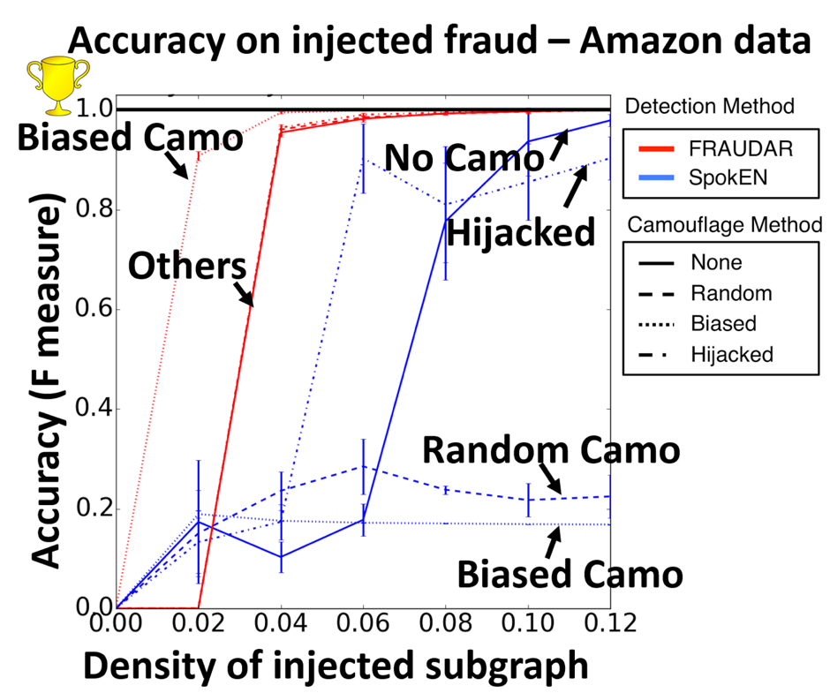
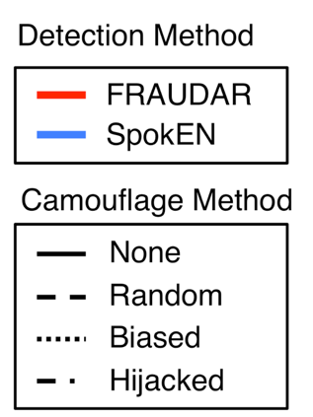
Experiments: Amazon Data
Detecting Anomalous Subgraphs

Slide 44
Case Study: Twitter Data
Followees (40M)
1.4B edges Density = 1.7 x 10⁻⁷
Followers
(40M)
4300
Detected by FRAUDAR
4000
Density = 0.66
Detecting Anomalous Subgraphs

Slide 45

Ground Truth: Twitter Data
Ground truth fraudsters:
users who tweeted TweeterGetter and TweepMe
Detecting Anomalous Subgraphs

Slide 46
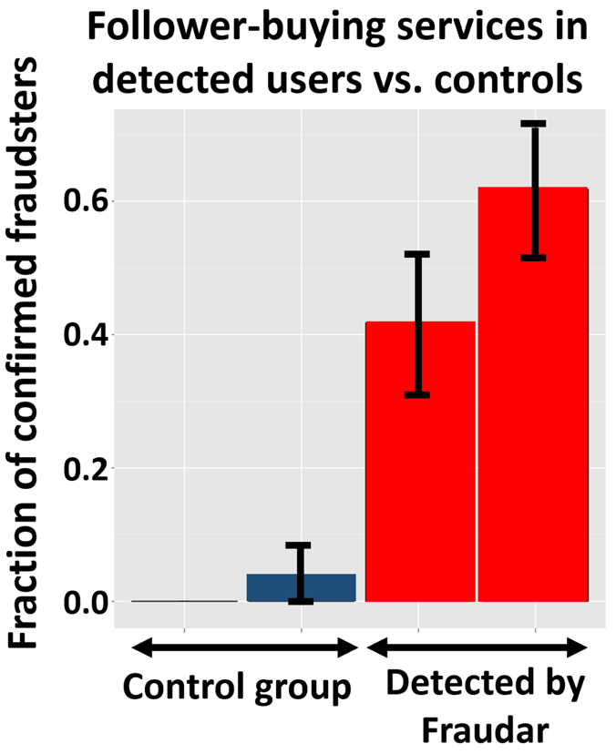
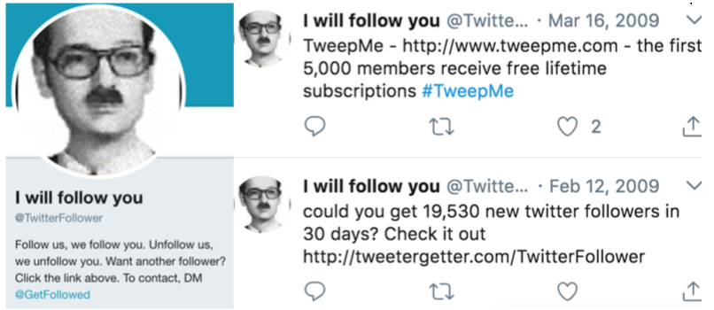
Case Study: Twitter Data
Example fraudster: adjacent to 80% of the dense block
Random
Degree
Followers
Followees
Controls
Detected users
Detecting Anomalous Subgraphs

Slide 47
Follow-up Work
How to measure anomalousness probabilistically?
Generalized Pareto Distributions (TellTail)
How to incorporate edge attributes? (e.g. time, rating stars)
Multimodal / tensor data (M-Zoom)
Detecting Anomalous Subgraphs
Notes:
Similar performance, no gurantee
Add section headers

Slide 48
TellTail (Probabilistic Subgraph Measures)
Probability density
1000 node subgraphs
1000 nodes
5000 edges
P(>5000 edges) = 10⁻⁶
No. of edges
5000
Erdos-Renyi model?
Detecting Anomalous Subgraphs

Slide 49
TellTail (Probabilistic Subgraph Measures)
Observation: subgraph mass distribution tails can be well-modeled using a Generalized Pareto Distribution (GPD).
TellTail: linear-time approach for finding unusual subgraphs using GPD
Detecting Anomalous Subgraphs

Slide 50
Research Topics
T2. Time
Series
T3. Dynamic
Graphs
T1. Graphs
• Link Fraud
• Ratings Fraud
• Dynamic Subgraphs
[KDD16, TKDD17, WSDM18]
[SDM16]
[ECML18, CIKM18]
Type of Anomaly
• Subtensors
• Power Grid
• Tensor Streams
[ICDM15, TKDE16, ECML16, WSDM17, TKDD18]
[ECML17, ISGT17, IJCAI18, SDM18]
[KDD17, WWW17, ECML17, CIKM17, TKDE18, SDM19]
• Patterns
[ECML17, SDM19]
Hooi, Shah, Beutel, Gunnemann, Akoglu, Kumar, Makhija, Faloutsos. “BIRDNEST: Bayesian Inference for Ratings-Fraud Detection.” SDM 2016.
Notes:
In this talk, I will describe 3 works: detecting link fraud in graphs, detecting ratings fraud in time series, and detecting subgraphs in dynamic graphs.

Slide 51
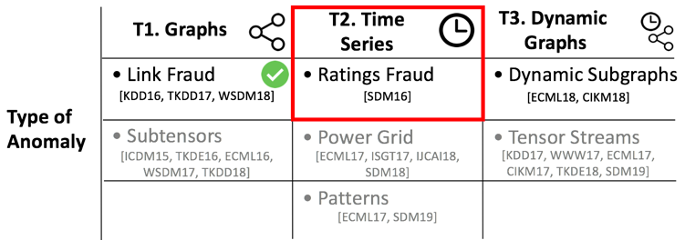


Road Map
T1. Detecting Camouflaged Link Fraud
T2. Detecting Ratings Fraud
Problem
Method
Experiments
T3. Detecting Anomalous Dynamic Subgraphs
Future Directions
Detecting Anomalous Event Sequences

Slide 52
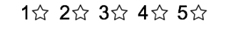
Introduction
Who is the most suspicious of these 3 users?
Detecting Anomalous Event Sequences
Notes:
Our main goal is to detect fake review boosting.
Look at these users: who is the most suspicious?

Slide 53
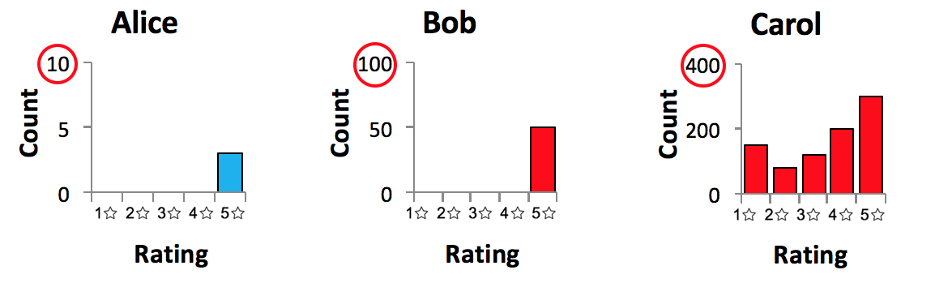
Introduction
Extreme distribution, but low certainty
Extreme distribution, high certainty
Typical distribution, high certainty
Detecting Anomalous Event Sequences
Notes:
Intuitively, how would we describe these users?
Alice has:
Bob has:
Carol has

Slide 54
Problem
Given:
Time-stamped ratings data by users for products
Output:
(Unsupervised) a suspiciousness score for each user, measuring how much they deviate from the norm
Alice | 5 (@5pm) |  | 4 (@ 6pm)
Bob |  | 3 (@ 3pm)
…
…
Detecting Anomalous Event Sequences
Notes:
Now we can formally describe our problem
We are given….
Our goal is to compute…

Slide 55
Road Map
T1. Detecting Camouflaged Link Fraud
T2. Detecting Ratings Fraud
Problem
Method
Experiments
T3. Detecting Anomalous Dynamic Subgraphs
Future Directions
Detecting Anomalous Event Sequences

Slide 56
Features for Detecting Fraud
What features are effective for catching fraudsters?
Ratings: fraudsters either boost products or attack competitors
Temporal: bot-driven attacks tend to occur in bursts, or at fixed intervals
1 min
Detecting Anomalous Event Sequences
Notes:
To start off, what features are useful for catching fraudsters?
Considering ratings: fraudsters are hired to either boost customers’ products, or attack competitors. So we expect them to either give mostly 5 star ratings, or mostly 1 star ratings.
Considering temporal patterns: fraudsters often use bots, which either perform all their activity in a short burst, or operate at fixed intervals, e.g. every minute or day.

Slide 57
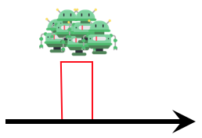
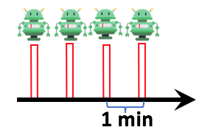
Using Temporal Information
How do we capture such bot-like temporal patterns?
Compute each user’s rating time differences:
Bursts:
Rating time differences
1s – 2s
Ratings given by Alice
Time
Bucketize
Time difference bucket
2s – 4s
Fixed Intervals:
1s – 2s
…
4 mins – 8 mins
32s– 64s
Time difference bucket
Detecting Anomalous Event Sequences
Notes:
How do we capture such bot-like temporal patterns?
Our answer is to compute a histogram of each user’s rating time differences.
Let these black dots represent the ratings given by Alice. We extract all time intervals between consecutive ratings, and compute a histogram, where the first bucket represents 1-2 seconds, then 2-4s, and so on.
Why does this work? Note that bursty behavior leads to many values in the first few buckets, while ratings at fixed intervals leads to many values in a single bucket. So either way, we get a skewed histogram which we can try to detect.

Slide 58
User Summaries
User summaries: compute each user’s rating histogram and temporal histogram
Alice | 5 (@5pm) |  | 4 (@ 6pm)
2s – 4s
1s – 2s
…
5 mins – 10 mins
Detecting Anomalous Event Sequences
Notes:
Now each user can be represented by their ”user summary”, which combines their rating histogram and their time difference histogram.

Slide 59


Model
How do we model normal behavior?
Cluster model: each user is a multinomial distribution (over 1 to 5 stars), drawn from a cluster-specific Dirichlet prior
“Lenient users”
“Complainers”
User 1
User 2
User 3
0.7
0.6
0.7
Probability
Probability
0.3
Probability
0.3
0.3
0.1
Detecting Anomalous Event Sequences
Notes:
How do we model normal behavior?
We use a cluster model, for example, imagine there are just 2 clusters, lenient users and complainers.
Let’s look at just ratings first. Each user is a 5 dimensional multinomial distribution, which is their fraction of 1 to 5 star ratings they give.
For example, user 1 has this multinomial distribution, and is drawn from a prior that is shared by all the lenient users.

Slide 60
Model
How do we model normal behavior?
User clusters jointly explain both rating and temporal behavior
“Lenient users”
“Complainers”
User 1
User 2
User 3
Probability
Probability
Probability
Time difference distributions
Time difference distributions
Detecting Anomalous Event Sequences
Notes:
These user clusters jointly explain both rating and temporal behavior. So, user 1’s time difference distribution is also drawn from a prior specific to lenient users.

Slide 61
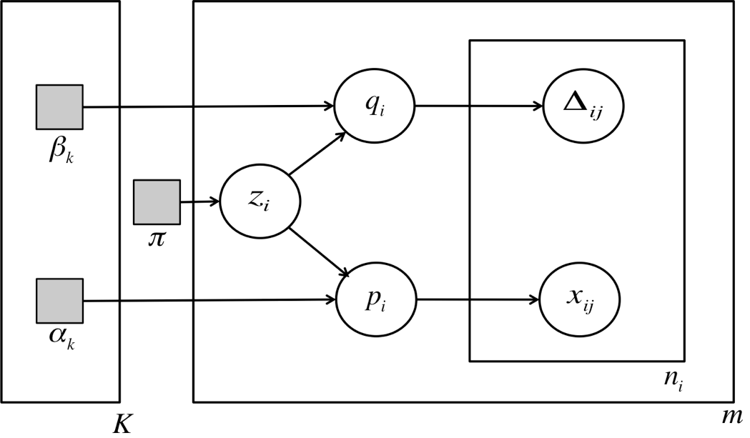
Model
Details
User’s temporal distribution
Cluster parameters
Observed
rating data
Cluster ID
User’s rating distribution
Detecting Anomalous Event Sequences
Notes:
This graphical model summarizes our cluster model. I won’t go into the details, but in the paper, we propose a linear-time EM like algorithm for fitting this model.

Slide 62
Model
Details
User’s temporal distribution
Cluster parameters
Observed
rating data
Cluster ID
User’s rating distribution
Detecting Anomalous Event Sequences
Notes:
For simplicity, in the subsequent slides we focus on the rating part of this model.

Slide 63
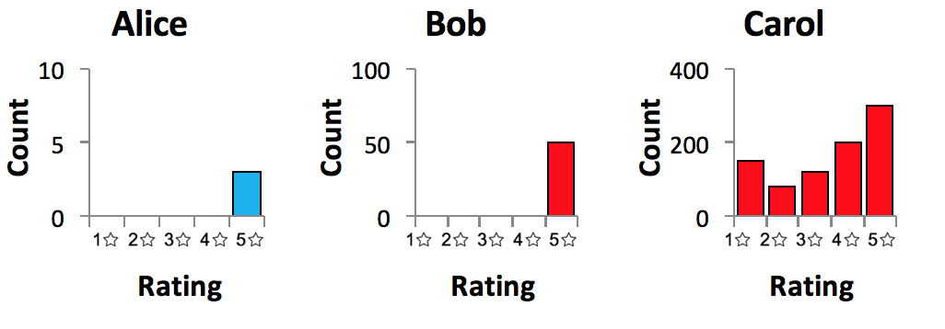
Anomalousness Score
How do we evaluate anomalousness of a user under this model?
Probability of 1 star
Complainers
Lenient users
Probability of 5 star
Detecting Anomalous Event Sequences
Notes:
Now that we have fit our model, how do we evaluate the anomalousness of each user?
I’ll explain using our earlier example of Alice, Bob and Carol.
This triangle represents the space of possible rating distributions – so the top corner is a user who only gives 4 star ratings, the right corner only gives 5 star ratings, and everywhere else is in between. In reality rating distributions are 5 dimensional, but I can only plot 2 dimensions. Recall that we fitted a cluster model, e.g. complainers and lenient users, which are represented as probability distributions in this space.

Slide 64
Anomalousness Score
How do we evaluate anomalousness of a user under this model?
Probability of 1 star
Global
Distribution
(Normal)
Probability of 5 star
Detecting Anomalous Event Sequences
Notes:
Now that we have fit our model, how do we evaluate the anomalousness of each user?
Rather than going into the math, I’ll use our earlier example of Alice, Bob and Carol.
This triangle represents the space of possible rating distributions – so the top corner is a user who only gives 1 star ratings, the right corner only gives 5 star ratings, and everywhere else is in between. In reality rating distributions are 5 dimensional, but I can only plot 2 dimensions. Recall that we fitted a cluster model, e.g. complainers and lenient users, which are represented as probability distributions in this space. We combine these together as the global distribution.

Slide 65
Anomalousness Score
Probability of 1 star
Extreme distribution, low certainty
Global
Distribution
(Normal)
Alice
Probability of 5 star
Detecting Anomalous Event Sequences
Notes:
Recall that Alice has only 4 ratings, which is an extreme distribution, but with low certainty.
The blue region represents our beliefs about Alice, which is large because we have high uncertainty.
We can see that it has high overlap with the global distribution, so it doesn’t disagree too much with the global distribution.

Slide 66
Anomalousness Score
Probability of 1 star
Extreme distribution, low certainty
CrossEntropy(Alice, Global) = 0.9
Global
Distribution
(Normal)
Alice
Details
“disagreement between distributions”
Probability of 5 star
= -𝔼_{x ∼ Alice} log P_{Global}(x)
Detecting Anomalous Event Sequences
Notes:
This can be measured by “cross entropy”, which is basically a measure of disagreement between distributions. Here it tells us that the distributions have some overlap, so the cross entropy is low.
The formula for cross entropy is here, but you can simply think of it as a measure of disagreement.

Slide 67
Anomalousness Score
Probability of 1 star
Extreme distribution, high certainty
CrossEntropy(Bob, Global) = 10.1
Global
Distribution
(Normal)
Details
Bob
“disagreement between distributions”
Probability of 5 star
= -𝔼_{x ∼ Bob} log P_{Global}(x)
Detecting Anomalous Event Sequences
Notes:
We do the same for Bob: the red region represents our beliefs about Bob. It is much smaller we are much more certain about Bob, and this also means it has little overlap with the global distribution, and the cross entropy is much larger.

Slide 68
Anomalousness Score
Probability of 1 star
Normal distribution, high certainty
CrossEntropy(Carol, Global) = 0.1
Global
Distribution
(Normal)
Details
Carol
“disagreement between distributions”
Probability of 5 star
= -𝔼_{x ∼ Carol} log P_{Global}(x)
Detecting Anomalous Event Sequences
Notes:
Finally, for Carol, her region is even smaller, but it overlaps a lot with the Global distribution, resulting in the smallest value of cross entropy.

Slide 69
Road Map
T1. Detecting Camouflaged Link Fraud
T2. Detecting Ratings Fraud
Problem
Method
Experiments
T3. Detecting Anomalous Dynamic Subgraphs
Future Directions
Detecting Anomalous Event Sequences

Slide 70
Experiments: Datasets
Flipkart: online e-commerce platform where users buy, sell and rate products
Software Marketplace (SWM): an app store where users rate apps
Detecting Anomalous Event Sequences

Slide 71
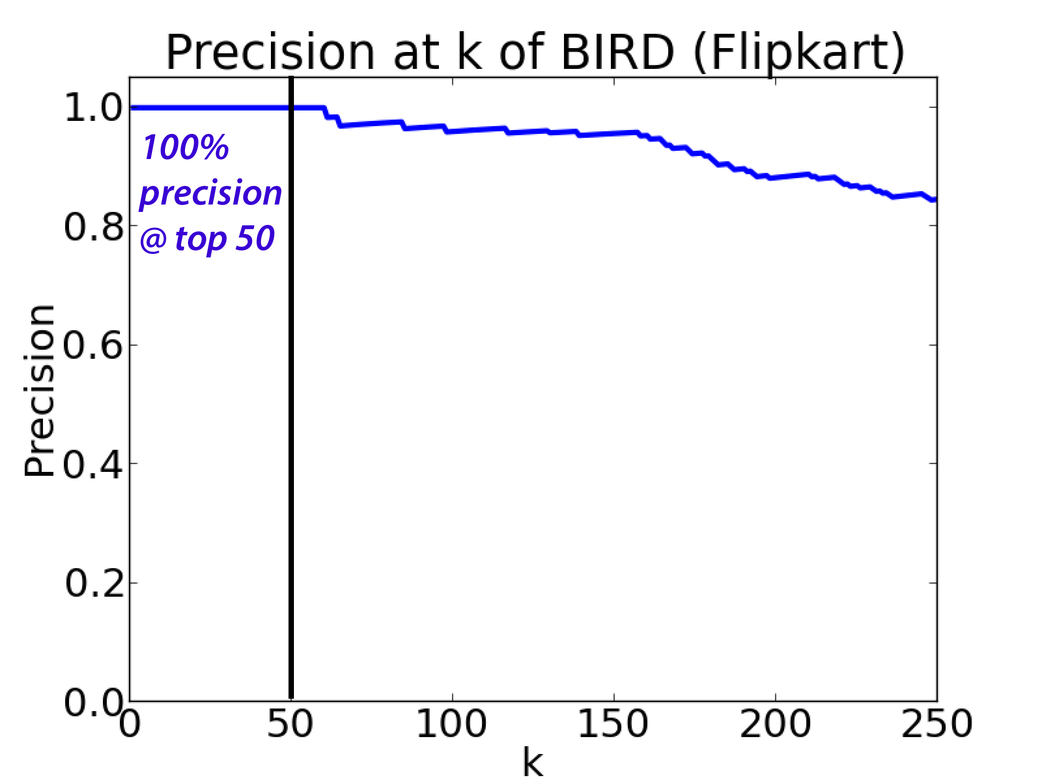
Results: Flipkart
Precision on Flipkart
100% precision at top 50
(Ground truth obtained from Flipkart employees)
Precision at top k
Number of detected users (i.e. k)
Detecting Anomalous Event Sequences
Notes:
On Flipkart, this plot shows precision at k for different values of k. Our method achieves 100% precision at top 50, where ground truth is obtained from Flipkart employees.

Slide 72
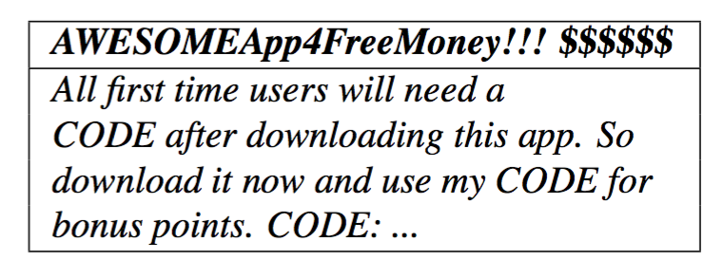
App Review Fraud
All 10 of the top 10 flagged user accounts are spammers advertising codes:
Detecting Anomalous Event Sequences

Slide 73
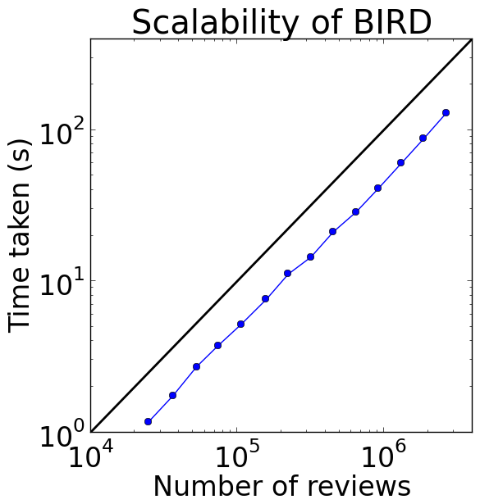
Scalability
Runs on 3M ratings in 2 minutes, with linear growth
Slope = 1
(linear)
Detecting Anomalous Event Sequences

Slide 74
Research Topics
T2. Time
Series
T3. Dynamic
Graphs
T1. Graphs
• Link Fraud
• Ratings Fraud
• Dynamic Subgraphs
[KDD16, TKDD17, WSDM18]
[SDM16]
[ECML18, CIKM18]
Type of Anomaly
• Subtensors
• Power Grid
• Tensor Streams
[ICDM15, TKDE16, ECML16, WSDM17, TKDD18]
[ECML17, ISGT17, IJCAI18, SDM18]
[KDD17, WWW17, ECML17, CIKM17, TKDE18, SDM19]
• Patterns
[ECML17, SDM19]
Hooi, Eswaran, Song, Pandey, Jereminov, Pileggi, Faloutsos. “GridWatch: Sensor Placement and Anomaly Detection in the Electrical Grid.” ECML-PKDD 2018.
Hooi, Eswaran, Pandey, Jereminov, Pileggi, Faloutsos. “ChangeDAR: Online Localized Change Detection for Sensor Data on a Graph.” CIKM 2018.
Notes:
In this talk, I will describe 3 works: detecting link fraud in graphs, detecting ratings fraud in time series, and detecting subgraphs in dynamic graphs.

Slide 75
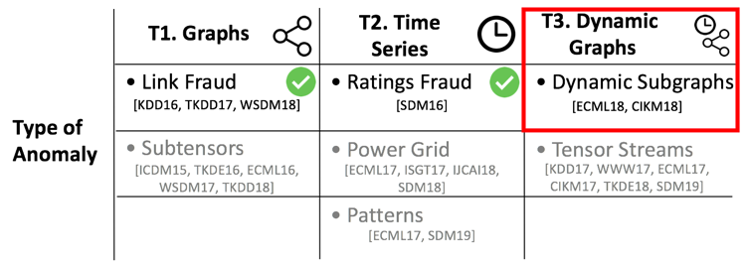

Road Map
T1. Detecting Camouflaged Link Fraud
T2. Detecting Ratings Fraud
T3. Detecting Anomalous Dynamic Subgraphs
Problem
Method (Overview)
Theoretical Results
Experiments
Future Directions
Detecting Anomalous Dynamic Subgraphs

Slide 76
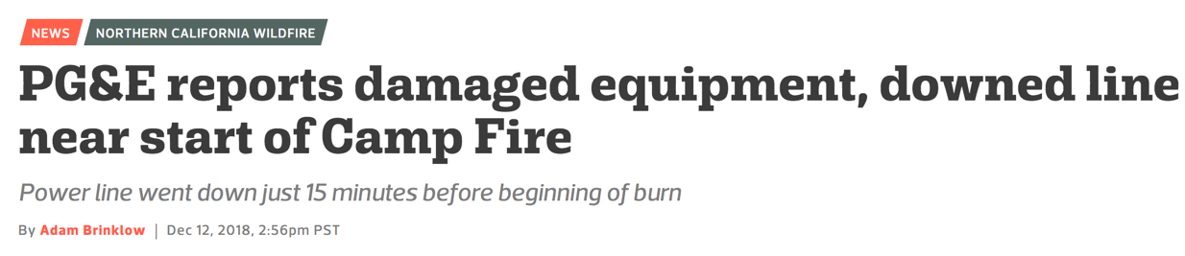
Introduction
Source: statescoop
Detecting Anomalous Dynamic Subgraphs
Notes:
Power lines can collapse due to winds, trees collapsing and so on, and this has been known to cause fires.
Recently, there was the deadliest wildfire in California history. Investigations found that the power company PG&E ....

Slide 77
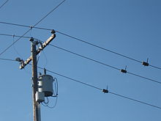
Electrical Grid Sensors
Detecting Anomalous Dynamic Subgraphs
Notes:
Fortunately, the power grid contains a network of sensors, which measure the current flowing over them. Our goal is to use them to detect when a failure occurs, as quickly as possible.

Slide 78
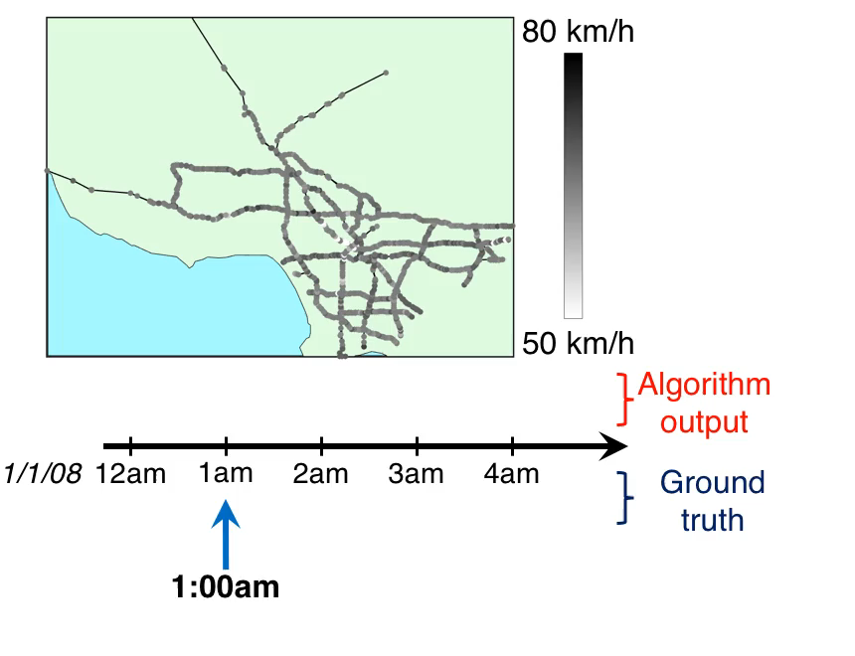
Example: Detecting Traffic Accidents
Detecting Anomalous Dynamic Subgraphs
Notes:
BEFORE: a very similar problem is also faced in traffic accident detection. This picture shows a road network of Los Angeles. Each gray dot represents a speed sensor. Color indicates the average speed of vehicles passing over the sensor. Our goal is to use this data to detect traffic accidents.
START: as time passes, there are slight fluctuations in speed, but it’s hard to make out any patterns or anomalies.
2.50am: At 2.50am, our algorithm detects an anomalous event at a small group of 3 sensors circled in red.
3.25am: At 3.25am, the ground truth traffic police report describes a 4 vehicle traffic collision blocking lanes. Note that this was 35 minutes after our algorithm detected the event.
3.50am: At 3.50am, a tow company was called and is en-route
4.30am: Finally, at 4.30am, the unit was cleared.

Slide 79
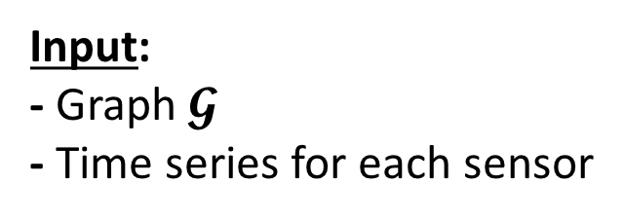
Problem 1: Change Scoring
Input:
- Graph $𝓖$
- Time series for each sensor
Edge sensor
Missing sensors
Node sensor
Detecting Anomalous Dynamic Subgraphs

Slide 80
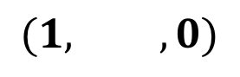
Problem 1: Change Scoring
Location of change (‘culprits’)
Current
time tick
Change
score
t=1
$$(1, ,0)$$
Edge sensor
Change
Scoring
(Problem 1)
Missing sensors
Node sensor
Detecting Anomalous Dynamic Subgraphs

Slide 81
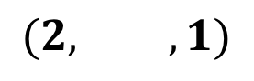
Problem 1: Change Scoring
Location of change (‘culprits’)
Current
time tick
Change
score
t=2
$$(1, ,0)$$
Edge sensor
$$(2, ,1)$$
Change
Scoring
(Problem 1)
Missing sensors
Node sensor
Detecting Anomalous Dynamic Subgraphs

Slide 82
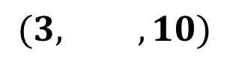
Problem 1: Change Scoring
Location of change (‘culprits’)
t=3
Current
time tick
Change
score
$$(1, ,0)$$
Edge sensor
$$(2, ,1)$$
Change
Scoring
(Problem 1)
$$(3, ,10)$$
Missing sensors
Node sensor
Detecting Anomalous Dynamic Subgraphs
Notes:
<Use colors/letters/pictures to show which node these are>

Slide 83
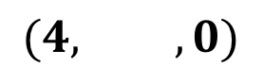
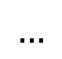
Problem 1: Change Scoring
Location of change (‘culprits’)
Current
time tick
Change
score
t=4
$$(1, ,0)$$
Edge sensor
$$(2, ,1)$$
Change
Scoring
(Problem 1)
$$(3, ,10)$$
Missing sensors
$$(4, ,0)$$
$$…$$
Node sensor
Detecting Anomalous Dynamic Subgraphs
Notes:
<Put red box around output of problem 1><change 0.1 to 1,etc><also add output to middle column>

Slide 84
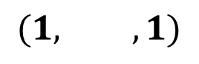
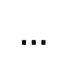
Problem 2: Change Detection
Location of change (‘culprits’)
Current
time tick
Change
score
$$(1, ,0)$$
$$(1, ,1)$$
Edge sensor
$$(2, ,1)$$
$$(2, ,1)$$
Change
Scoring
(Problem 1)
Change
Detection
(Problem 2)
$$(3, ,10)$$
$$(3, ,10)$$
Missing sensors
$$(4, ,0)$$
$$(4, ,0)$$
$$…$$
$$…$$
Node sensor
Detecting Anomalous Dynamic Subgraphs

Slide 85
Road Map
T1. Detecting Camouflaged Link Fraud
T2. Detecting Ratings Fraud
T3. Detecting Anomalous Dynamic Subgraphs
Problem
Method (Overview)
Theoretical Results
Experiments
Future Directions
Detecting Anomalous Dynamic Subgraphs

Slide 86
Intuition: Change Scoring
• “PA: sudden change at time 3”
• “PA-NY: sudden change at time 3”
• “CA: no sudden changes”
• “PA & PA-NY: sudden change at time 3”
t=3
PA
1a. Sensor
scoring
1b. Group
scoring
PA-NY
How can we quantify and compare changes?
CA
Answer: Information theory (bits saved)!
Detecting Anomalous Dynamic Subgraphs
Notes:
Circle the anomaly (SG & KL)

Slide 87
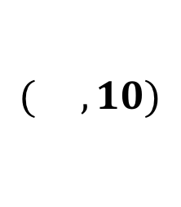
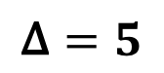
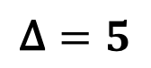
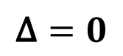
Algorithm Overview: Change Scoring
Sensor-level change scores (for time t)
t
Location of change (‘culprits’)
$$\text{Δ}=5$$
Group change
score
$$\text{Δ}=5$$
1a. Sensor
scoring
1b. Group
scoring
$$( ,10)$$
$$\text{Δ}=0$$
Information theoretic framework
Detecting Anomalous Dynamic Subgraphs
Notes:
Add a slide before this for intuition “singapore and malaysia – sudden change on wed, all others ok”
Answer: information theory

Slide 88
Algorithm Overview: Change Scoring
Sensor-level change scores (for time t)
t
Location of change (‘culprits’)
$$\text{Δ}=5$$
Group change
score
$$\text{Δ}=5$$
1a. Sensor
scoring
1b. Group
scoring
$$( ,10)$$
$$\text{Δ}=0$$
Information theoretic framework
Detecting Anomalous Dynamic Subgraphs
Notes:
Add a slide before this for intuition “singapore and malaysia – sudden change on wed, all others ok”
Answer: information theory

Slide 89
ChangeDAR: `Bitsave’ Scores
How do I find the best group of changes?
t
Δ_{v}(t): change score at node v at time t
Δ_{e}(t): analogous, for edge e
Detecting Anomalous Dynamic Subgraphs
Notes:
<explain reasoning for grouping>
<Put circle around culprits>
<Poland: much more complicated>

Slide 90
Prize-Collecting Steiner Tree
Background
Cost
-$10
Revenue
$20
$30
-$15
-$10
$20
-$10
Which roads should we build?
-$15
$10
$20
Detecting Anomalous Dynamic Subgraphs

Slide 91
Prize-Collecting Steiner Tree
Background
Cost
-$10
Revenue
$20
$30
-$15
-$10
Net Profit
= $20 + $30 + $20 + $20
- $10 - $10 - $10 = $60
$20
-$10
-$15
$10
$20
Detecting Anomalous Dynamic Subgraphs
Notes:
How to group parts of the graph that are both misbehaving?

Slide 92
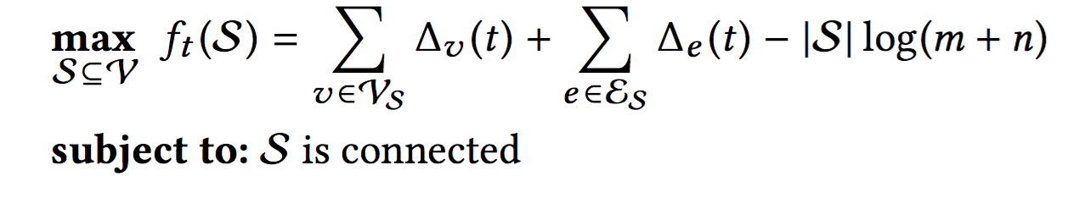
ChangeDAR: Grouping Step
Details
We want a connected subgraph with high bitsave scores
t
S
Bits needed to encode S
Bits saved at
nodes and edges
Approach: apply Prize-Collecting Steiner Tree algorithm with bitsave scores as “prize” scores
Detecting Anomalous Dynamic Subgraphs
Notes:
Repeat goal: given sensors, describe succinctly

Slide 93
Road Map
T1. Detecting Camouflaged Link Fraud
T2. Detecting Ratings Fraud
T3. Detecting Anomalous Dynamic Subgraphs
Problem
Method (Overview)
Theoretical Results
Experiments
Future Directions
Detecting Anomalous Dynamic Subgraphs

Slide 94
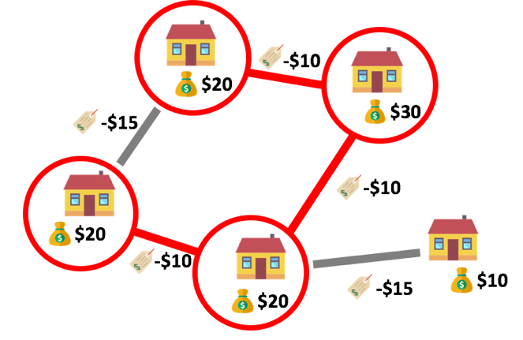
Theoretical Results
Details
How well does this work? Are there provable bounds?
Theorem 1: Approximation Factor (Problem 1)
The Change Scoring objective (Problem 1) can be optimized in near-linear time with approximation factor 2.
Detecting Anomalous Dynamic Subgraphs

Slide 95
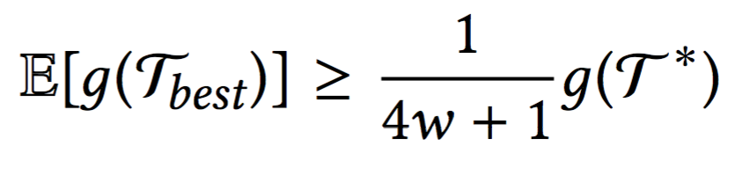
Theoretical Results
Details
Theorem 2: Average Case Approximation Factor (Problem 2)
The Change Detection objective (Problem 2) can be optimized in near-linear time with constant approximation factor in expectation:
approximates
Score
Score of
algorithm
Window
Optimal score
Scores of
algorithm
Optimal
Detecting Anomalous Dynamic Subgraphs

Slide 96
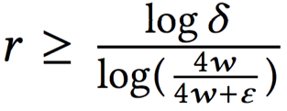
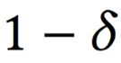
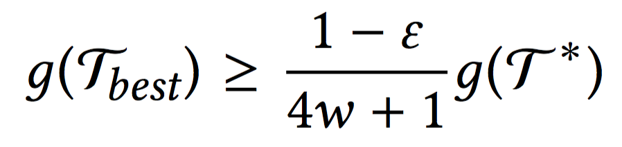
Theoretical Results
Details
Theorem 3: High Probability Approximation Factor (Problem 2)
The Change Detection objective (Problem 2) can be optimized in near-linear time with constant approximation factor with high probability.
If , then with probability at least :
approximates
Score
Score of
algorithm
Optimal score
Window
δ quantile
Optimal
Detecting Anomalous Dynamic Subgraphs

Slide 97
Road Map
T1. Detecting Camouflaged Link Fraud
T2. Detecting Ratings Fraud
T3. Detecting Anomalous Dynamic Subgraphs
Problem
Method (Overview)
Theoretical Results
Experiments
Future Directions
Detecting Anomalous Dynamic Subgraphs

Slide 98
Experiment 1: Power Grid Failures
Poland High Voltage Network
Injected power
line breakage
Subgraph detected
by ChangeDAR
Detecting Anomalous Dynamic Subgraphs

Slide 99
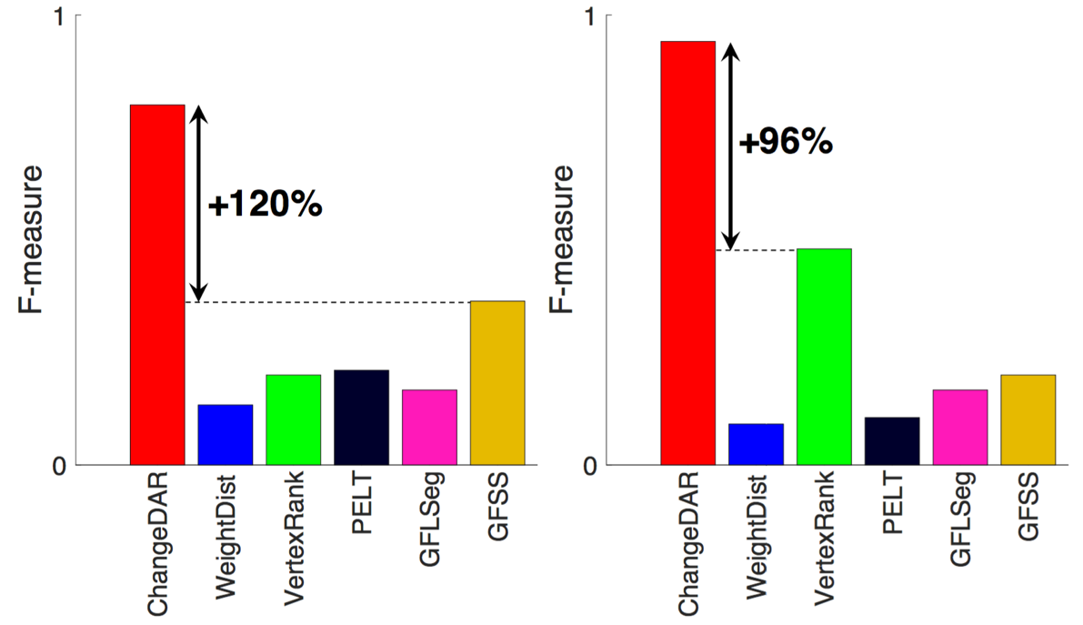
Experiment 1: Power Grid Failures
PolandHVN1
PolandHVN2
Baselines:
Dynamic Graph Change Detection (WeightDist, VertexRank)
Model-based (PELT)
Fused Lasso (GFLSeg)
Graph Fourier Scan Statistic (GFSS)
Detecting Anomalous Dynamic Subgraphs

Slide 100

Experiment 1: Power Grid Failures
PolandHVN3
PolandHVN4
Baselines:
Dynamic Graph Change Detection (WeightDist, VertexRank)
Model-based (PELT)
Fused Lasso (GFLSeg)
Graph Fourier Scan Statistic (GFSS)
Detecting Anomalous Dynamic Subgraphs

Slide 101
Experiment 2: Traffic Accidents
+70%
+227%
Detecting Anomalous Dynamic Subgraphs

Slide 102
Research Topics
T2. Time
Series
T3. Dynamic
Graphs
T1. Graphs
• Link Fraud
• Ratings Fraud
• Dynamic Subgraphs
[KDD16, TKDD17, WSDM18]
[SDM16]
[ECML18, CIKM18]
Type of Anomaly
• Subtensors
• Power Grid
• Tensor Streams
[ICDM15, TKDE16, ECML16, WSDM17, TKDD18]
[ECML17, ISGT17, IJCAI18, SDM18]
[KDD17, WWW17, ECML17, CIKM17, TKDE18, SDM19]
• Patterns
[ECML17, SDM19]
Notes:
In this talk, I will describe 3 works: detecting link fraud in graphs, detecting ratings fraud in time series, and detecting subgraphs in dynamic graphs.

Slide 103

Road Map
T1. Detecting Camouflaged Link Fraud
T2. Detecting Ratings Fraud
T3. Detecting Anomalous Dynamic Subgraphs
Future Directions
Future Directions

Slide 104
Vision: Practical Anomaly Detection
P1. Applications
P2. Interpretability
Practical Anomaly Detection
P3. Adversarial Robustness
Future Directions
Notes:
My vision is a practical anomaly detection framework that meets real world challenges.
In particular it should be able to 1) cope with different types of anomalies in different types of applications; 2) it should provide useful and interpretable output; and 3) it should be robust against adversaries.

Slide 105

P1. Applications
Can we detect other types of anomalies in more domains?
Flows
(money laundering)
Images / Video / Spatiotemporal
(pollution, fires, diseases, …)
Medical
(post-coma EEG)
Current
Short Term
Long Term
Dynamic Graphs [CIKM18]
Spreading Anomalies
General Spatiotemporal Anomalies
Future Directions
Notes:
Firstly, can we detect other types of anomalies in more domains?
For example, in money laundering, we want to detect unusual flows of funds between bad actors. The adversaries are trying to conceal these flows, so it is hard to detect them using usual methods. I have a collaboration with an anonymous bank working on this problem.
Another example is spatiotemporal anomalies: this includes a wide range of datasets: pollution, fire, disease, etc. Let’s look at a video of a volcanic eruption: <SHOW VIDEO> Recall that ChangeDAR detects events along a subgraph, but this type of anomaly has a complex temporal pattern which is more challenging to detect.
Finally, in the medical domain, I’m working with a coma recovery doctor in University of Pittsburgh, on how to use brain EEG data to monitor patients while they recover from comas.

Slide 106
P2. Interpretability
How can we provide more interpretable and useful output for users?
Anomaly Detection System
Newly received data
User
Future Directions

Slide 107
P2. Interpretability
Anomaly Detection System
Anomaly? Yes/No
Newly received data
Location of anomaly
ChangeDAR
User
Future Directions

Slide 108
P2. Interpretability
Anomaly Detection System
Anomaly? Yes/No
Scatterplot
Newly received data
Location of anomaly
Variable
importance
Explanation for anomaly
.
.
.
Decision rules
×
.
.
User
…
Future Directions

Slide 109
P2. Interpretability
Anomaly Detection System
Anomaly?
Newly received data
“Not an
anomaly”
Location
Explanation
User
Future Directions

Slide 110
P2. Interpretability
Anomaly Detection System
Updated output
Anomaly?
Anomaly?
Newly received data
“Not an
anomaly”
Location
Location
Explanation
Explanation
User
Future Directions

Slide 111

P2. Interpretability
Current
Short Term
Long Term
Localization
[CIKM18]
Anomaly
Explanation
Interactive Anomaly Detection & Explanation
Future Directions

Slide 112
P3. Adversarial Robustness
How can we detect adversaries who are trying to avoid detection?
Adversaries
avoids
Detection
Algorithm
catches
Current
Short Term
Long Term
Static Graphs
[KDD16]
Profit Model
Adversarially Robust Framework
Future Directions

Slide 113
Conclusion: Anomaly Detection
A capacity for surprise is an essential aspect of our mental life, and surprise itself is the most sensitive indication of how we understand our world and what we expect from it.
Daniel Kahnemann, Thinking, Fast and Slow
Notes:
I’d like to end with a quote by …
Anomaly detection is ultimately about teaching computers how to be surprised, and as we have seen, this has a wide range of useful applications which I’m excited about.

Slide 114
Conclusion: Anomaly Detection
A capacity for surprise is an essential aspect of our mental life, and surprise itself is the most sensitive indication of how we understand our world and what we expect from it.
Daniel Kahnemann, Thinking, Fast and Slow
Connections:
Applications:
Anomaly Detection: teaching computers to be surprised
Graph Mining
Time Series Analysis
Data Engineering
Optimization
Machine Learning
…
Social Networks
Transportation
Medical Sensors
Air Quality
Cybersecurity
…
Notes:
I’d like to end with a quote by …
Anomaly detection is ultimately about teaching computers how to be surprised, and as we have seen, this has a wide range of useful applications which I’m excited about.

Slide 115
Other Work
[1] Feng, Liu, Faloutsos, Hooi, Shen, Cheng. Anomaly Detection in Large Graphs based on Vision-guided Summarization, PAKDD 2019.
[2] Shin, Kim, Hooi, and Faloutsos. Think before You Discard: Accurate Triangle Counting in Graph Streams with Deletions. ECML-PKDD 2018.
[3] Shin, Hooi, and Faloutsos. Fast, Accurate and Flexible Algorithms for Dense Subtensor Mining. TKDD 2018.
[4] Kumar, Hooi, Makhija, Kumar, Faloutsos, and Subrahmanian. REV2: Fraudulent User Prediction in Rating Platforms. WSDM 2018.
[5] Feng, Liu, Faloutsos, Hooi, Shen and Cheng. EagleMine: Vision-Guided Mining in Large Graphs. KDD ODD Workshop 2018.
[6] Hooi, Shin, Song, Beutel, Shah, and Faloutsos. Graph-Based Fraud Detection in the Face of Camouflage. TKDD, 2017.
[7] Shin, Hooi, Kim and Faloutsos. D-Cube: Dense-Block Detection in Terabyte-Scale Tensors. WSDM 2017.
[8] Shin, Hooi, and Faloutsos. M-Zoom: Fast Dense-Block Detection in Tensors with Quality Guarantees. ECML-PKDD 2016.
[9] Jiang, Beutel, Cui, Hooi, Yang, and Faloutsos. Spotting Suspicious Behaviors in Multimodal Data: A General Metric and Algortihms. TKDE 2016.
[10] Hooi, Song, Beutel, Shah, Shin, and Faloutsos. FRAUDAR: Bounding Graph Fraud in the Face of Camouflage. KDD 2016. KDD Best Paper Award (Research Track)
[11] Papalexakis, Hooi, Pelechrinis, and Faloutsos. Power-Hop: A Pervasive Observation for Real Complex Networks. PLoS ONE 2016.
[12] Jiang, Beutel, Cui, Hooi, Yang, and Faloutsos. A General Suspiciousness Metric for Dense Blocks in Multimodal Data. ICDM 2015.
Example Applications Studied
Social Networks
Graphs
Review Fraud
Cybersecurity
[13] Hooi and Faloutsos. Branch and Border: Partition-Based Change Detection in Multivariate Time Series, SDM 2019.
[14] Hooi, Song, Pandey, Jereminov, Pileggi, and Faloutsos. StreamCast: Fast and Online Mining of Power Grid Time Sequences. SDM 2018.
[15] Pudi Chen, Liu, Shi, Hooi, Wang, Cheng. NeuCast: Seasonal Neural Forecast of Power Grid Time Series. IJCAI 2018.
[16] Hooi, Liu, Smailagic, and Faloutsos. BEATLEX: Summarizing and Forecasting Time Series with Patterns. ECML-PKDD 2017.
[17] Song, Hooi, Jereminov, Pandey, Pileggi, and Faloutsos. PowerCast: Mining and Forecasting Power Grid Sequences. ECML-PKDD 2017.
[18] Chan, Lai, Hooi and Davies. The Message or the Messenger? Inferring Virality and Diffusion Structure from Online Petition Signature Data. SocInfo 2017.
[19] Jereminov, Pandey, Song, Hooi, Pileggi, and Faloutsos. Linear Load Model for Robust Power System Analysis. IEEE ISGT 2017.
[20] Hooi, Shah, Beutel, Gunnemann, Akoglu, Kumar, Makhija, and Faloutsos. BIRDNEST: Bayesian Inference for Ratings-Fraud Detection. SDM 2016.
Online Petitions
Time Series
Medical Sensors
Air Quality
[21] Hooi, Shin, Lamba, and Faloutsos. SMF: Drift Aware Matrix Factorization with Seasonal Patterns, SDM 2019.
[22] Hooi, Eswaran, Pandey, Jereminov, Pileggi, and Faloutsos. ChangeDAR: Online Localized Change Detection for Sensor Data on a Graph. CIKM 2018.
[23] Liu, Hooi, and Faloutsos. A Contrast Metric for Fraud Detection in Rich Graphs, TKDE 2018.
[24] Nigam, Shin, Bahulkar, Hooi, Hachen, Szymanski, Faloutsos, Chawla. ONE-M: Modeling the Co-evolution of Opinions and Network Connections. ECML-PKDD 2018.
[25] Hooi, Eswaran, Song, Pandey, Jereminov, Pileggi, Faloutsos. GridWatch: Sensor Placement and Anomaly Detection in the Electrical Grid. ECML-PKDD 2018. ECML-PKDD Runner-up Best Student Data Mining Paper Award.
[26] Liu, Hooi, Faloutsos. HoloScope: Topology-and-Spike Aware Fraud Detection. CIKM 2017.
[27] Lamba, Hooi, Shin, Faloutsos, and Jurgen Pfeffer. ZOORANK: Ranking Suspicious Entities in Time-Evolving Tensors. ECML-PKDD 2017.
[28] Liu, Hooi, and Faloutsos Fraud Detection using Graph Topology and Temporal Spikes. KDD MLG Workshop 2017.
[29] Shah, Beutel, Hooi, Akoglu, Gunnemann, Makhija, Kumar, and Faloutsos. EdgeCentric: Anomaly Detection in Edge-Attributed Networks. ICDM DMCS 2016.
[30] Takahashi, Hooi, and Faloutsos. AutoCyclone: Automatic Mining of Cyclic Patterns and Anomalies by Robust Tensor Factorization. WWW 2017.
[31] Shin, Hooi, Kim, and Faloutsos. DenseAlert: Incremental Dense-Subtensor Detection in Tensor Streams. KDD 2017.
Online Commerce
Dynamic
Graphs
Disease Forecasting
Power Grids
Transportation
Others
[32] Costa, Campilho, Hooi, Smailagic, Kitani, Liu, Faloutsos and Galdran. EyeQual: Accurate, Explainable, Retinal Image Quality Assessment. IEEE ICMLA 2017.
[33] Hooi, Song, Papalexakis, Agrawal, and Faloutsos. Matrices, Compression, Learning Curves: formulation, and the GROUPNTEACH algorithms. PAKDD 2016.
[34] Hooi, Song, Papalexakis, Agrawal, and Faloutsos. Education, Learning and Information Theory. ICDM ACCESS Workshop 2015.
Medical Imaging
Notes:
I have other work that I didn’t present today, but I would be happy to take questions about any of them as well.

Slide 116












Thank You
Papers, software, data: http://www.andrew.cmu.edu/user/bhooi
Email: bhooi@andrew.cmu.edu
Thanks to:
Sponsors:
Admins:
Collaborators:
Ann
Stetser
Tony
Mareino
Icons from flaticon.com
Notes:
Replace with los angeles

Slide 117
Spare
Completed / Proposed
T2.2-T2.3: Related Completed Work

Slide 118



Themes and Approaches
A1. Graph-Based Approximation Algorithms
A2. Statistical Methods
A3. Domain-Aware Models

